Slide 1

GRAPH THEORY, APPLICATIONS AND COMBINATORICS
Surabhi Narayan
Department of Computer Science & Engineering

Slide 2

GRAPH THEORY, APPLICATIONS AND COMBINATORICS
Graph Applications
Surabhi Narayan
Department of Computer Science & Engineering

Slide 3
Graph Theory, Applications and Combinatorics
Graph Applications
Shortest Path Problem
In graph theory, the shortest path problem is the problem of finding a path between two vertices (or nodes) in a graph such that the sum of the weights of its constituent edges is minimized.
The variations of the problem are :
The single-source shortest path problem
The single-destination shortest path problem
The all-pairs shortest path problem

Slide 4
Graph Theory, Applications and Combinatorics
Graph Applications
Dijkstra’s algorithm is one of the most popular algorithms for solving many single-source shortest path problems having non-negative edge weight.
It was conceived by computer scientist Edsger W. Dijkstra in 1956 and published three years later.
Digital Mapping Services in Google Maps
Social Networking Applications
Telephone Network
IP routing to find Open shortest Path First
Designate file server
Robotic Path

Slide 5
Graph Theory, Applications and Combinatorics
Graph Applications
The diagram below shows roads connecting nearby localities to university. The values on each arcs represent the distance in kilometers along each road. A student of the university lives in locality ‘A’. Use Dijkstra’s algorithm to find the minimum distance for student’s journey to university represented as ‘P’.
B
7
D
8
F
8
13
5
9
6
5
P
A
11
6
C
6
E
7
G

Slide 7
Graph Theory, Applications and Combinatorics
Graph Applications
Three boys walk to school J from their homes at A, B, and C. The graph shows the network of roads near their homes and school. The numbers on each arc represent the distance in meters along each road. Use Dijkstra’s algorithm to fins which boy lives nearest to the school.
A
190
E
90
H
90
150
100
300
110
250
250
B
J
D
G
120
110
280
130
C
240
F
80
I

Slide 9
Graph Theory, Applications and Combinatorics
Graph Applications
The following network shows in time(mins) train journey between seven stations.
Given that there is no time delay in passing through a station find the shortest time to travel from A to G.
Find the shortest time to travel from A to G if in reality each time the train passes through a station, excluding A and G an extra 10 minutes is added to the journey time.
B
65
F
35
50
25
30
20
35
30
A
E
D
G
40
35
75
60
C

Slide 11
Graph Theory, Applications and Combinatorics
Graph Applications

Slide 13
Graph Theory, Applications and Combinatorics
Graph Applications

Slide 15
Graph Theory, Applications and Combinatorics
Graph Applications
Bellman Ford Algorithm
The Bellman-Ford algorithm is an extension of Dijkstra’s algorithm which calculates the shortest distance from the source point to all of the vertices. While Dijkstra’s algorithm just works for edges with positive distances, the Bellman-Ford algorithm works for negative distances as well.
Applications:
The Bellman-Ford algorithm has several real-world use cases, including:
Finding negative weight cycles.
Calculating the smallest possible heat gain/loss in a chemical reaction.
Finding the most efficient way to convert currencies.

Slide 16
Graph Theory, Applications and Combinatorics
Graph Applications
Bellman Ford Algorithm
List down all the edges of the graph. This can be done easily if the graph is represented by an adjacency list.
Calculate the number of iterations with “V – 1”. The number of iterations will be equal to the number of vertices because the shortest distance to an edge can be adjusted |V-1| times at maximum.
Start with an arbitrary vertex and assign it the minimum distance of zero. All other nodes should be assigned infinity since we are exaggerating the actual distances.
In each iteration, update the distance for each edge if the new distance is smaller than the one assigned before. The distance to each node will be the cumulative distance from the starting node to this particular node.
We need to consider all the iterations to make sure that all ​possible paths are considered. If we do this, we will end up with the shortest distance.

Slide 17
Graph Theory, Applications and Combinatorics
Graph Applications
Find the shortest distance from ‘a’ using Bellman Ford Algorithm
b
2
8
a
1
e
5
4
4
d
c
-3

Slide 18
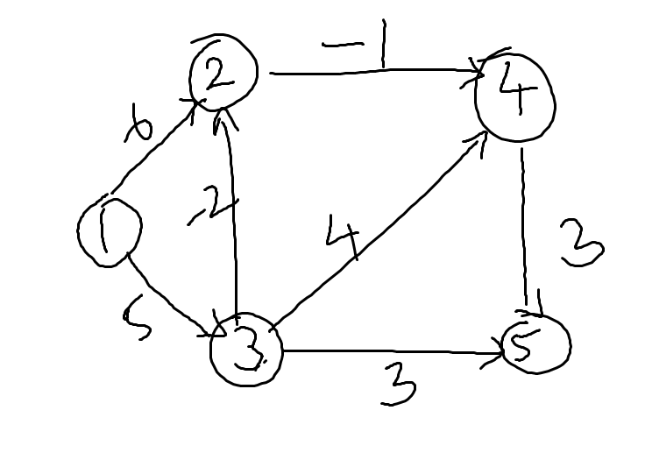
Graph Theory, Applications and Combinatorics
Graph Applications
Find the shortest distance from 1 using Bellman Ford Algorithm

Slide 19
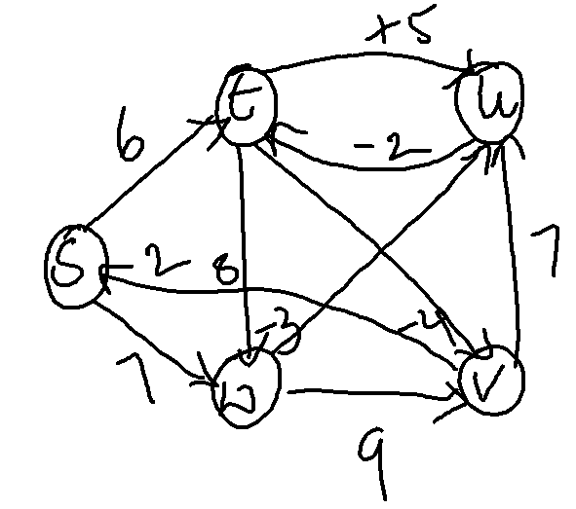
Graph Theory, Applications and Combinatorics
Graph Applications
Find the shortest distance from S using Bellman Ford Algorithm

Slide 20
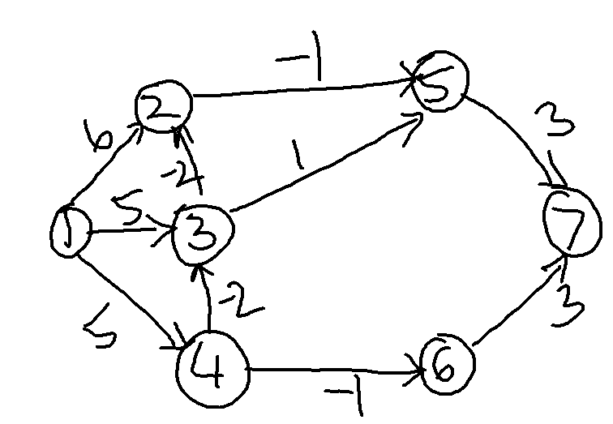
Graph Theory, Applications and Combinatorics
Graph Applications
Find the shortest distance from 1 using Bellman Ford Algorithm

Slide 21
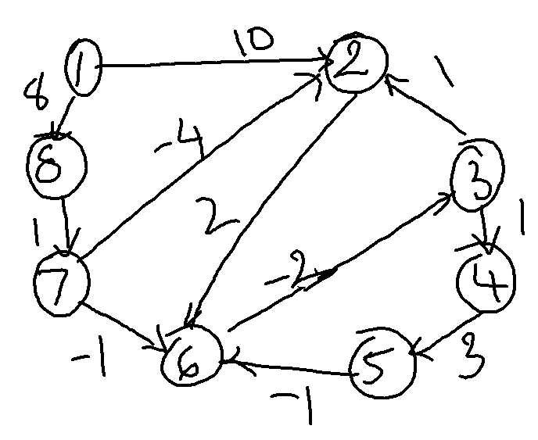
Graph Theory, Applications and Combinatorics
Graph Applications
Find the shortest distance from 1 using Bellman Ford Algorithm

Slide 22
Graph Theory, Applications and Combinatorics
Graph Applications
In 1962 Chinese mathematician, Kwan Mei-Ko was interested in a postman delivering mail. It is the problem that the Chinese Postman faces: he wishes to travel along every road in a city in order to deliver letters, with the least possible distance. The problem is how to find a shortest closed walk of the graph in which each edge is traversed at least once, rather than exactly once. In graph theory, an Euler cycle in a connected, weighted graph is called the Chinese Postman problem.

Slide 23
Graph Theory, Applications and Combinatorics
Graph Applications
An algorithm for finding an optimal Chinese postman route is:
List all odd vertices.
List all possible pairings of odd vertices.
For each pairing find the edges that connect the vertices with the minimum weight.
Find the pairings such that the sum of the weights is minimised.
On the original graph add the edges that have been found in Step 4.
The length of an optimal Chinese postman route is the sum of all the edges added to the total found in Step 4.
A route corresponding to this minimum weight can then be easily found.

Slide 24
Graph Theory, Applications and Combinatorics
Graph Applications
A county council is responsible for maintaining the below network of roads. The number on each edge is the length of the road in miles. The council office is based at A. A council worker has to inspect all the roads starting and finishing at A. Find the length of an optimal Chinese postman route.

Slide 25
Graph Theory, Applications and Combinatorics
Graph Applications
The vertices of the following network represents the chalets in a small holiday park and the arcs represent the paths between them with the lengths of the paths given in meters. A gardener wishes to sweep all the paths starting and finishing at P and to do so by walking as short distance as possible. Apply Chinese postman algorithm to find the shortest distance the gardener must walk and gives shortest possible route.

Slide 26
Graph Theory, Applications and Combinatorics
Graph Applications
A police motor cyclist based at town A has to travel along each of the roads atleast once before returning to base at A. Find the minimum total distance the motor cyclist must travel.

Slide 28
Graph Theory, Applications and Combinatorics
Graph Applications
Optimal Assignment Problem
An assignment problem can be easily solved by applying Hungarian method which consists of two phases. In the first phase, row reductions and column reductions are carried out. In the second phase, the solution is optimized on iterative basis.
Phase 1
Step 0: Consider the given matrix.
Step 1: In a given problem, if the number of rows is not equal to the number of columns and vice versa, then add a dummy row or a dummy column. The assignment costs for dummy cells are always assigned as zero. Step 2: Reduce the matrix by selecting the smallest element in each row and subtract with other elements in that row.

Slide 29
Graph Theory, Applications and Combinatorics
Graph Applications
Phase 2:
Step 3: Reduce the new matrix column-wise using the same method as given in step 2.
Step 4: Draw minimum number of lines to cover all zeros.
Step 5: If Number of lines drawn = order of matrix, then optimally is reached, so proceed to step 7. If optimally is not reached, then go to step 6.
Step 6: Select the smallest element of the whole matrix, which is NOT COVERED by lines. Subtract this smallest element with all other remaining elements that are NOT COVERED by lines and add the element at the intersection of lines. Leave the elements covered by single line as it is. Now go to step 4.

Slide 30
Graph Theory, Applications and Combinatorics
Graph Applications
Step 7: Take any row or column which has a single zero and assign by squaring it. Strike off the remaining zeros, if any, in that row and column (X). Repeat the process until all the assignments have been made.
Step 8: Write down the assignment results and find the minimum cost/time.

Slide 31
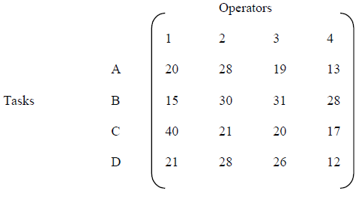
Graph Theory, Applications and Combinatorics
Graph Applications

Slide 32
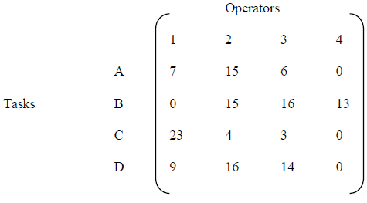
Graph Theory, Applications and Combinatorics
Graph Applications
Row-wise Reduction

Slide 33
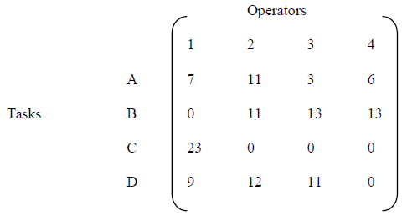
Graph Theory, Applications and Combinatorics
Graph Applications
Column-wise Reduction Matrix

Slide 34
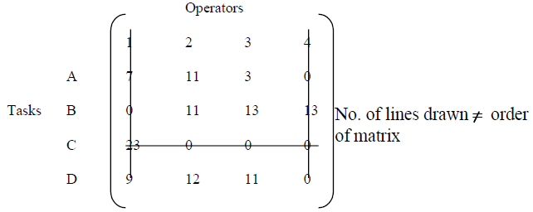
Graph Theory, Applications and Combinatorics
Graph Applications
Matrix with all Zeros Covered

Slide 35
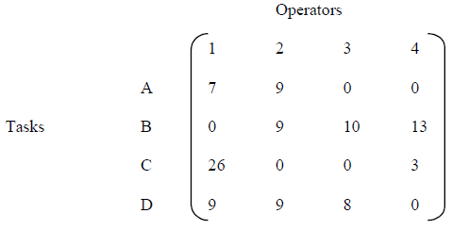
Graph Theory, Applications and Combinatorics
Graph Applications
Subtracted or Added to Uncovered Values and Intersection Lines Respectively

Slide 36
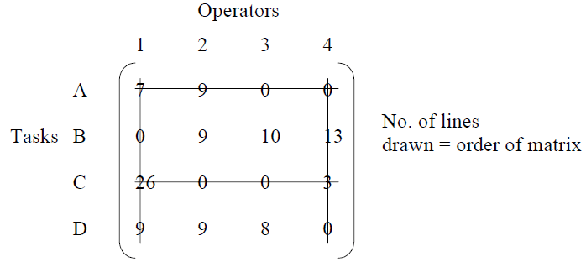
Graph Theory, Applications and Combinatorics
Graph Applications
Optimality Matrix

Slide 37
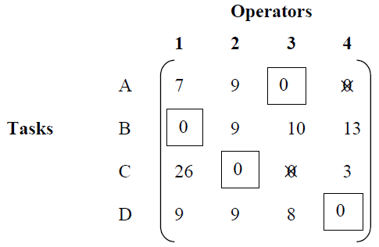
Graph Theory, Applications and Combinatorics
Graph Applications
Final Assignment

Slide 38
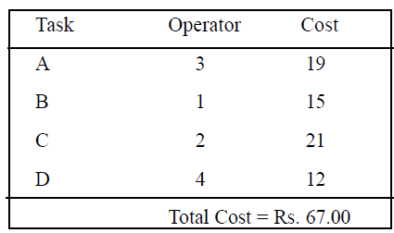
Graph Theory, Applications and Combinatorics
Graph Applications
Final Assignment

Slide 39
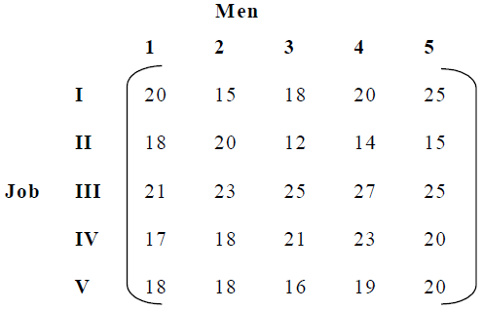
Graph Theory, Applications and Combinatorics
Graph Applications
Assignment

Slide 40
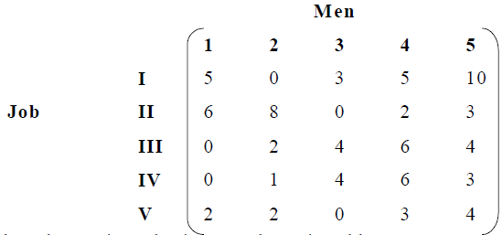
Graph Theory, Applications and Combinatorics
Graph Applications
Row-wise Reduction Matrix

Slide 41
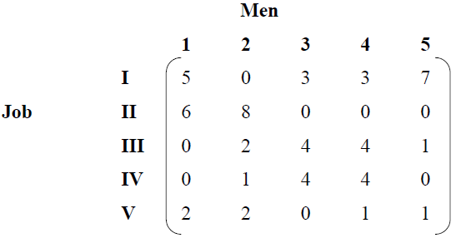
Graph Theory, Applications and Combinatorics
Graph Applications
Column-wise Reduction Matrix

Slide 42
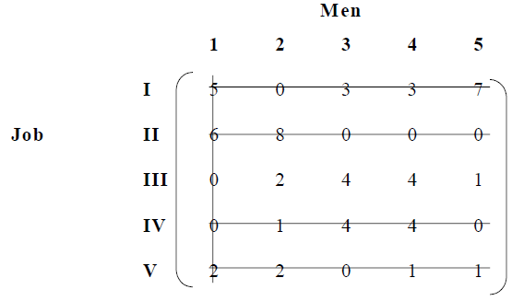
Graph Theory, Applications and Combinatorics
Graph Applications
Matrix will all Zeros Covered

Slide 43
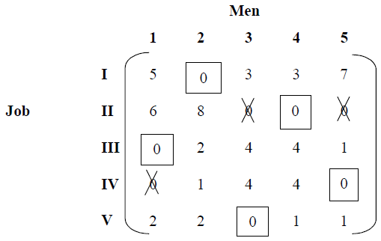
Graph Theory, Applications and Combinatorics
Graph Applications
Optimal Assignment

Slide 44
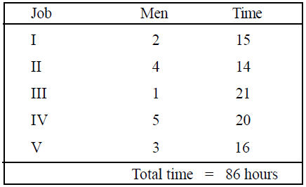
Graph Theory, Applications and Combinatorics
Graph Applications
Optimal Assignment

Slide 45
THANK YOU
Surabhi Narayan
Department of Computer Science &Engineering
surabhinarayan@pes.edu

